Slide 1
Deployment and Operations for Software Engineers 2nd Ed
Chapter 12 – Design Options

Slide 2
Outline
Service oriented architecture Microservice architecture Microservice qualities Microservices in context Communication styles
Structuring request and response data

Slide 3
Service Oriented Architecture
A service-oriented architecture (SOA) has
A collection of distributed components that provide and/or consume services.
Enterprise Service Bus (ESB).
An ESB supports
Discovery for consumers
Providers must register with the ESB
Communication between providers and consumers
Protocol translation

Slide 4
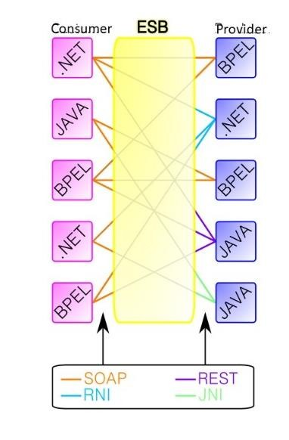
ESB
Any consumer can talk to any producer and vice versa
ESB performs protocol translation

Slide 5
Components in a SOA
Providers and consumers are
standalone entities
deployed independently.
Components have interfaces that describe the services they request from other components and the services they provide.
Services can be implemented heterogeneously, using whatever languages and technologies are most appropriate

Slide 6
Example of the use of SOA
Suppose your organization is a bank that has just acquired another bank.
You now have two copies of loan management software, fraud detection software, and account management software.
Each of these systems has their own user interface and process assumptions.
.

Slide 7
Example of the use of SOA
Integration using SOA
Create a uniform database for accounts and loans.
Attach the new and legacy databases to the ESB
Attach legacy systems to the ESB.
Use the ESB to translate from the original bank specific formats to and from the new uniform database format.

Slide 8
Discussion questions
It is possible that components in the SOA are managed by the different organizations. What additional elements are required if the producer and comsumer components are managed by different organizations.
Develop a use case for SOA that is different from the banking example.

Slide 9
Outline
Service oriented architecture Microservice architecture Microservice qualities
Microservices in context Communication styles
Structuring request and response data

Slide 10
Microservice architecture
Around 2002 Amazon promulgated the following rules for their developers.
All teams will henceforth expose their data and functionality through service interfaces.
Teams [software] must communicate with each other through these interfaces.

Slide 11
Microservice architecture
There will be no other form of inter-process communication allowed: no direct linking, no direct reads of another team’s data store, no shared- memory model, no backdoors whatsoever. The only communication allowed is via service interface calls over the network.
It doesn’t matter what technology they [services] use.

Slide 12
Microservice services
The basic packaging unit is a service. Services are independently deployable.
The current location of a service must be dynamically discovered.
Mechanisms for discovery-
DNS,--for VMs
ESB—for services in SOA
Service mesh—for microservices in an orchestration system

Slide 13
Microservice communication
Microservices communicate only via network messages.
Network communication is an inherent portion of a microservice architecture.
It is not a coincidence that microservice architectures date from around 2002 since that is when cloud computing with fast network communication was possible.

Slide 14
Technology usage
One common cause of integration errors is version incompatibility.
Technology independence allows each team to independently
Choose implementation language
Choose libraries and dependencies
No need to coordinate with other teams on any of these choices.

Slide 15
Microservices and teams
Amazon has a “two-pizza” rule--Every team can be fed with two pizzas.
In practice this rule limits team size to roughly seven people.
If the service grows so that seven people is insufficient, the service will be split in two.

Slide 16
Microservice ownership
Each microservice is owned by a single team. No coordination between teams is necessary over a microservice
A single team may own multiple microservices, but no microservice has multiple owners.
Limited coordination leads teams to treat other teams as they would treat outside entities--defensive programming.

Slide 17
Discussion questions
Compare microservices and SOA with respect to the ownership of the components.
What is the relation between microservices and APIs?

Slide 18
Outline
Service oriented architecture Microservice architecture
Microservice qualities
Microservices in context Communication styles
Structuring request and response data

Slide 19
Microservice qualities
As microservice architecture can be analyzed in terms of its quality attributes
Availability,
Modifiability,
Performance
Reusability
Scalability
Security

Slide 20
Availability
If an instance of a microservice fails, it will be detected by the load balancer which may be a portion of the orchestrator.
The load balancer knows the instance has failed because it fails to send a health message within a specified time.
The load balancer will not send any more requests to the failed instance
The auto scaling capability may create a new instance to replace he failed instance.

Slide 21
State in microservices
If the microservice is stateless, then a failed instance can be replaced just by creating a new one.
If the microservice is stateful, then the state lost when the microservice failed must be recovered. The mechanisms for doing this depend on where the state is stored.

Slide 22
Modifiability
Measures of modifiability are coupling and cohesion.
Modifiability is enhanced by having low coupling among services and high cohesion within a single service.
If a single service performs a single function
Cohesion is likely high.
Coupling will depend on the overlap between the function performed by the service and functions performed by other services.

Slide 23
Performance
Microservices depend crucially on network traffic
A network message will take longer than a memory reference.
The comparison of a system implemented as microservices to one implemented in a less distributed fashion will depend on how many messages must be sent in the microservice design.
.

Slide 24
Performance
Techniques for improving the performance of a microservice design include
Caching
Sending messages in binary rather than in text form
Colocating services that have high rates of communication between them.

Slide 25
Reusability
Reuse requires locating common functions and isolating them in a single service.
This leads to low fan out among the services and more services involved in satisfying a single request.

Slide 26
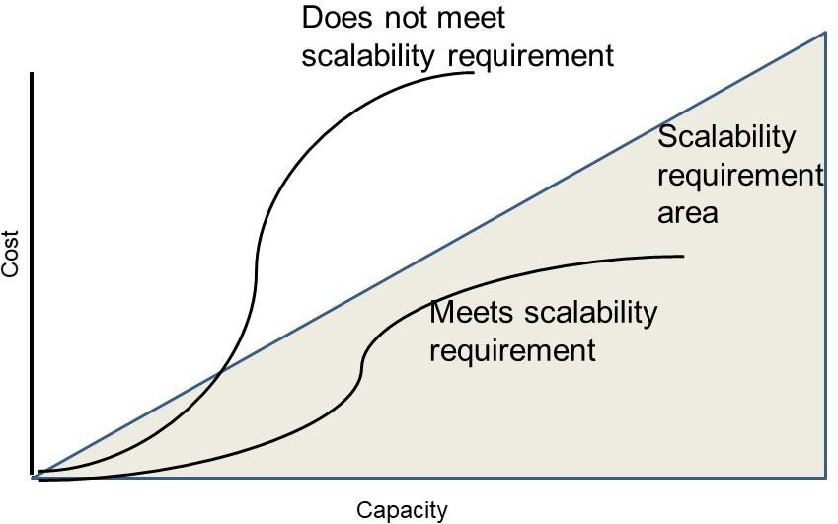
Scalability
A system is scalable if increasing resources results in linear or sub- linear increases in costs.
This depends on the cloud
provider’s charging model.
Typically, adding instances of a stateless microservice will increase the costs linearly.

Slide 27
Security
Some practices to increase security in a microservice architecture are
Use HTTPS instead of HTTP.
Apply patches promptly.
Delete unused resources promptly.
Do not write security-sensitive code such as password managers yourself.
Do not embed credentials into code or scripts.

Slide 28
Discussion questions
What is the tradeoff between performance and reusability in microservices?
What is the tradeoff between modifiability and performance in a microservice architecture?

Slide 29
Outline
Service oriented architecture Microservice architecture Microservice qualities Microservices in context Communication styles
Structuring request and response data

Slide 30
Containers and microservices
Microservices communicate only with messages, and containers are accessible only through network interfaces that are intended for message-based communication.
.

Slide 31
Containers and microservices
A pod is a collection of related containers that are deployed and scaled together.
The services that make up a PaaS or service mesh are ideal candidates to be collected in a pod with the microservice you are developing.
Placing the platform service resources near the microservice you are developing will reduce the latency of messages and resource usage.
Containers provide more limited resources than VMs. Microservices are small and single purpose, and typically require fewer resources than multifunction processes.

Slide 32
Service mesh discovery
Service meshes provide discovery services where the services that can be discovered are limited to those that satisfy some set of criteria.
Data center locality. The service should be local to the requesting microservice.
Another criterion can be canary or A/B testing. A canary or A/B test designates a collection of microservices as belonging to the version being tested. If the orchestrator is aware of which microservices are participating in the tests, it can populate the relevant discovery services appropriately.
.

Slide 33
Service mesh discovery
Geographic locality. Services that interact with users can be specialized to language, to region, or other user visible attributes. Again, the orchestrator can populate the discovery service with specialized microservices.

Slide 34
Other service mesh microservices
These are some microservices that can be bundled with your application microservices and discovered by the service mesh
Configuration
Distributed coordination
Logging
Tracing
Metrics
Dashboard
Alerts

Slide 35
Protecting against failure
Recall the long tail. A request may fail because of problems somewhere in the chain of servicing the request that is out of your control.

Slide 36
Protecting against failure
Hedged requests. Make more requests than you need and then cancel the requests (or ignore responses) after you receive sufficient responses. For example, if you want 10 new servers, issue 12 “launch servier” requests and cancel the 2 unsatisfied after 10 have completed.
Alternative request. Issue 10 requests, for example. When 8 requests have been satisfied, issued 2 more. After 10 total requests have been satisfied, cancel the unsatisfied requests.

Slide 37
Discussion questions
Why is configuration a service recommended for inclusion in a pod with your miroservice?
Is it possible to have a microservice architecture without packaging the microservices in containers? What are the tradeoffs involved in doing this?

Slide 38
Outline
Service oriented architecture Microservice architecture Microservice qualities Microservices in context Communication styles
Structuring request and response data

Slide 39
Communication styles
Mechanisms for communication among components in a distributed system:
Remote Procedure Call (RPC)
REpresentational State Transfer (REST).
Querying an API

Slide 40
Remote Procedure Call (RPC)
An RPC message allows code on one host to call a procedure (function or method) on another host.
It contains four elements.
The IP address of the recipient
The name of the target procedure
The version number of the target procedure
An untyped data block that contains the request arguments or the response results.

Slide 41
Steps in sending an RPC message
The basic steps involved, for most RPC implementations, are as follows.
Write a package definition file to define the software interface. A package definition file looks like a standard procedure declaration with parameters of specified types.
Run the RPC compiler to produce the stub code.

Slide 42
Sending an RPC message
Link together the client modules (program, stub, RPC run time system) to make the client module.
Link the server modules (a standard main program, the server stub, the server routines themselves, and the RPC run time system).
Then your code can call a procedure on another node using IP address, procedure name, and procedure version.

Slide 43
Using RPC
A remote procedure call creates a strong contract between the sender and the recipient. Both sides must agree on exactly which procedures (methods) will be implemented by the service, and on how those procedures will be numbered.
RPC requests can be stateful or stateless.
A stateful request depends on previous requests made by the client to the service. E.g. you must first open a log file before you can write to it.
A stateless request has no such constraints.

Slide 44
Message transport
One option for message transport is TCP (or TLS if you want to improve security).
Some RPC implementations use an HTTP POST request to send the request and response.

Slide 45
Representational State Transfer
RPC requires close coupling of a client to a service. They must agree on
Parameters
Procedure names
Representational State Transfer (REST) allows looser coupling.
REST was developed in parallel with the emergence of the World Wide Web.

Slide 46
Elements of REST
Requests are stateless.
There is no assumption in the protocol that any information is retained from one request to the next.
Any state maintained is through agreement between client and server but not supported in the protocol
Information exchanged is textual
services and methods are accessed by name.
The web was designed to be heterogeneous and hetrogenity requires textual exchange of information

Slide 47
REST methods
REST restricts methods to PUT, GET, POST, and DELETE.
REST requires that the element be self-describing by labeling it with an internet media data type (or MIME type) so that any receiver knows how to interpret the data.
HTTP is used as the mechanism for exchanging data

Slide 48
REST vs RPC
RPC favors high performance
RPC supports a programming style that allows distributed services to be called just like local services,
REST promotes interoperability
REST enables rapid and independent evolution of clients and servers.

Slide 49
REST vs RPC
Both are used extensively to build microservice-based systems:
RPC is applied to parts of the system where interactions between services are well understood or where performance is a priority,
REST is used in end-user-facing services and areas that are evolving faster.

Slide 50
Querying an API
GraphQL is primary representative of this style.
Motivated by mobile cdevices.
Providing service has an explicit typed statement of the data is might provide. – Provider schema
Client has an explicit statement of data it wishes to receive. Client schema
Client sends query in terms of client schema and providing service responds with JSON.

Slide 51
GraphQLvs REST
GraphQL uses less bandwidth than REST
Client only asks for what it needs.
REST eservice provider is not aware of client needs and so will provide all data it knows about.
GraphQL does not provide good support for ad hoc queries. REST does.

Slide 52
Discussion questions
Could the World Wide Web have been developed using RPC?
How does the World Wide Web manage state communication between two services if REST is stateless?

Slide 53
Outline
Service oriented architecture Microservice architecture Microservice qualities
Microservices in context Communication styles
Structuring request and response data

Slide 54
Message packaging protocols
Requests and responses in both RPC and REST contain data elements that must be interpreted by both the client and the service. This data must be packaged into a message sent over the network.
Three common protocols for packaging messages are
Extensible Markup language (XML)
Protocol Buffers
JSON

Slide 55
Extensible Markup Language (XML)
XML adds annotations (called tags) to a textual document.
The tags specify how to interpret the information in the document by breaking the information into chunks or fields and identifying the data type of each field.
XML is a meta-language: It allows you to define a customized language to describe your data.
Your customized language is defined by an XML schema, which is itself an XML document.

Slide 56
HTML and XML
HTML is a markup language much like XML
XML is designed for data transferred between services
HTML is designed to describe the layout of web pages.

Slide 57
Protocol Buffers
Protocol Buffers provide a specific syntax for the package definition file.
This defines the structure of the untyped block of an RPC message.
They are usually used in conjunction with gRPC, a binary form of RPC.
Protocol Buffers use data types that are close to programming- language data types, making marshaling and unmarshaling efficient.

Slide 58
Nessage passing between different languages
Suppose you wish Service A (written in Java) and Service B (written in Python) to communicate.
Place your protocol buffer specification in a .proto file.
Language specific compilers translate the .proto file into code that marshals, unmarshals, and sends a message.
Compile the .proto file using the Java Protocol buffer compiler. Link it into Service A
Compile the .proto file using the Python Protocol Buffer compiler. Link it into Service B

Slide 59
Nessage passing between different languages
Services A and B can now communicate using the procedures generated by the two language specific .proto compilers.

Slide 60
Explicit schema
XML and Protocol Buffers have explicit schemas.
This allows checking to see if messages are specified correctly.
If interfaces are described explicitly, they can be saved in a data base
Allows search to see which variables are used by which services
Provides up to date documentation of the architecture.

Slide 61
JavaScript Object Notation (JSON)
JSON structures data as name/value pairs and array data types.
JSON is independent of any programming language.
Like XML, JSON is a textual representation,
Unlike XML, JSON has no schema capability to define a valid document structure.

Slide 62
Discussion questions
XML requires reading in the entire message before marshaling can begin. Why?
JSON can perform marshaling as the message is read in. Why?

Slide 63
END OF OF CHAP 12

